Slide 1
I am lab
Guidance: Prof. Dr Vahid Hadavi
Team: Devadharsini Muralidharan
Lovedeep kaur
Sachin minhas
Nirmal Dilip kumar
Satishkumar muralidharan

Slide 2
Vision & mission statement
Second opinion for people
Easy reporting of Scans in Laboratories
Instant Scan results - <10 minute wait time
Quick doctor appointments – reducing hospital traffic
Virtual appointments instantaneously with available doctors
Reduce manual error with AI
Easily chat with bots to resolve FAQs

Slide 3
MoScow & CATwoe analysis
MoSCoW
CATWOE
Must Have: AI Prediction model, Easy Reporting, Email report
Should Have: Instant report generation, Appointment, Chatbot
Could Have: Login, Approval Request, Options for scan types
Wont Have: Registration, Dashboard, Appointment Virtual Invite -VC
Customers: Doctors, Radiologists, Laboratories, Patients – Easy using tool/features
Actors: SME – Doctors & Radiologists, Developers
Transformation: Instant Reporting, Second opinions, easy consulting virtually, in-person appointments
World View: Amidst the Covid situation and in future, we wont have to spend time at hospitals waiting for reports, and consultations
Owner: Developers with the help of SME
Environment: Need the support of the laboratories and hospitals to build a better accurate model, and feature enhancements

Slide 4
Product line
Based on the MoSCoW Analysis, Our Prototype will have the following features:
  A website
  Prediction Model
  Instant report generation and Email
  Appointment Fixing
  Chatbot

Slide 5
technology
Website: HTML, CSS, Java Script
Convolution Neural Network: Python, Tensorflow, Flask
SMTP – Gmail
Cloud: Google Cloud Platform, Herokuapp
Chatbot: Google Dialog flow
Integration: Flask, Kommunicate

Slide 6

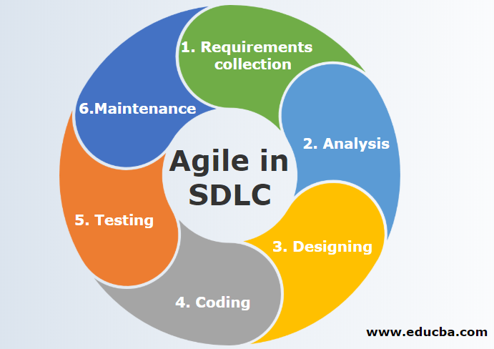
Agile SDLC
Weekly 3 meetings
Design Developments:
  AI Model
  Webapp
  Email
  Report
  Integration
Testing

Slide 7
Data sources
National Institute of Health Clinical Centre – Chest X Ray Data
  Dataset split for training, testing and validation
  Images categorized as Normal and Infected – Bacteria/Virus
  Dataset size >10GB
Kaggle

Slide 8
workspace
To have a common workspace for everyone to develop, deploy and test solution
  Created a Virtual Machine with Google Cloud Platform
  VM has required NB and dataset
  Tried the AWS Sagemaker Jupyter Notebook & Google Colab (easier with Colab)

Slide 9
Convolution Neural Network
Image Processing:
  Resize images to 200x200
  X-rays – To Black & White
  Data Augmentation to generate new images
  Labels

Slide 10
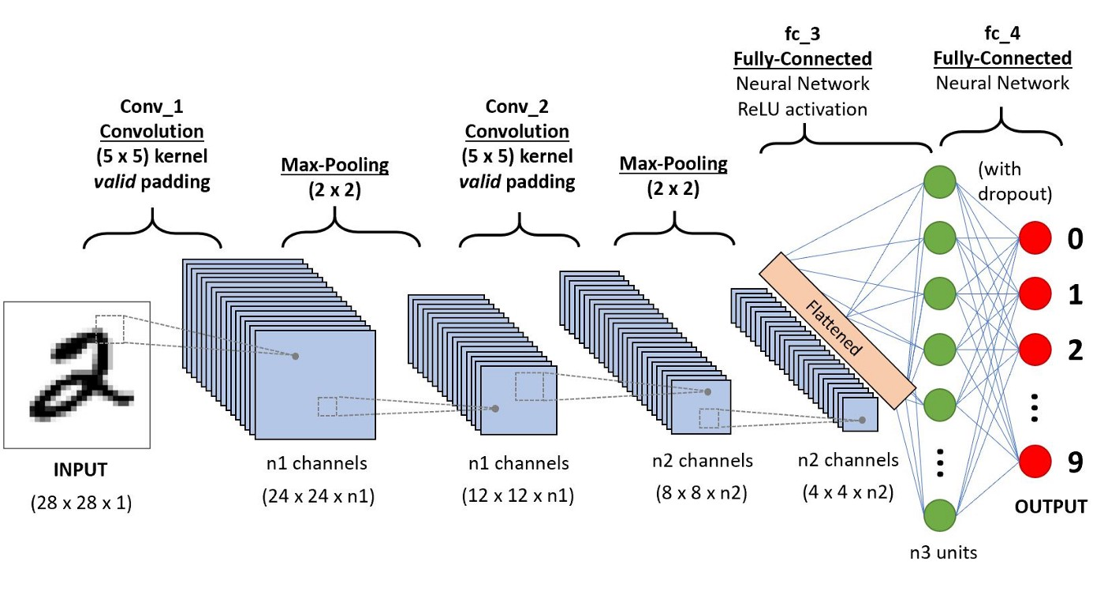

Slide 11
CNN Model
2D Convolution Layer – With Stride 1
Then Max Pooling
Again 2D Conv Layer & Max Pooling
Flattening the Layer, to a Dense network and Relu Activation function
ReLu – max (0, x)
Number of Epoch: 30
Accuracy: 83%
Save model to h5 file for later use

Slide 12
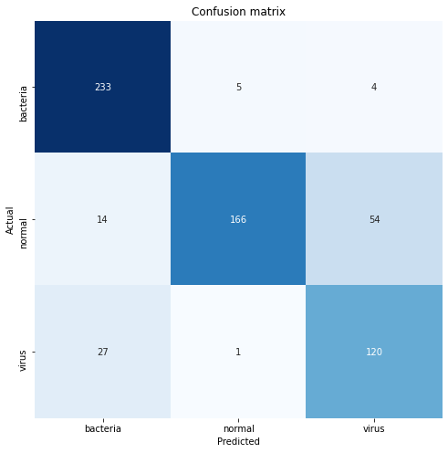
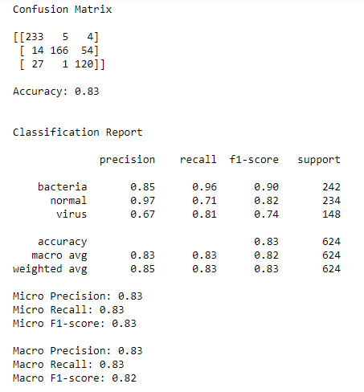
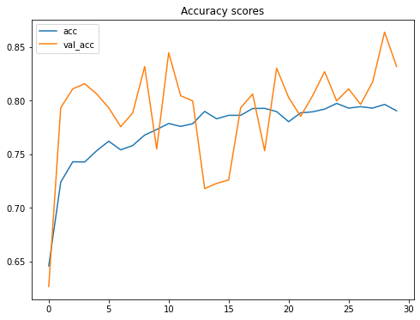

Slide 13
chatbot
Google Dialogflow
Intents & Responses based
Added few required conversations – To do reporting, Appointments
We could add more FAQs
We could also add some diseases and symptoms
Integrated using kommunicate

Slide 14
Website
Frontend - Prototype
  Upload image option
  Email field to send the copy of the report
  Blogs
  Make an appointment
  Contact numbers, and Email ids
  Our developers images

Slide 15
reporting
Use image to predict if the Xray has Pneumonia or not
Based on prediction PDF report will be generated
PDF will have the probability of having the infection
PDF will also have the symptoms of the infection
Disclaimer/Terms & Conditions

Slide 16
deployment
First Trial – GCP APP Engine (Difficulty with debugging/error detection)
  Website – Success
  Website with Chatbot – Success
  Website with Email – Failure(With report)/ Success(Without report)
  Website with model – Failure (Model size too big to upload to server)
Second Trial – Heroku (Good documentation/easy deployment/easy debugging logs with Git) with Github integration
  Website – Success
  Website with Chatbot – Success
  Website with Email – Success(With/Without report)
  Website with model – Success

Slide 17
failures
Google Cloud App Engine Deployment
  Debugging logs in GCP
  Flask Integration: Logs not so clear to diagnose reporting features in website

Slide 18
Learning from failures
Heroku – Good Documentation
  Easy Debugging with logs from Git
Model – Compression/Pruning to reduce size and retain accuracy
SMTP – Reduce the security of Gmail, 2- factor verification to generate app password for login (different from gmail password)

Slide 19
Future product goals
Registration for Users
Registration for Doctors/Radiologists
Incorporate Oncology Scans – Tumor detection
Selection options for Chest Xray/Brain MRI/CT
Virtual Meeting links for Video Conferencing
Dashboard to view incoming Users
Subscriptions/Partnerships

Slide 20
prototype
Link: http://labtechies.herokuapp.com/
Demo

Slide 21
monetization
Pay per report model (For second Opinions)
Partnership/Tie up with Hospitals & Laboratories to increase the accuracy of the model and incorporate new features and provide a package for development and support (Yearly contracts/Bundle packages)
Engage doctors to Enroll on the site & Quick Doctor visits – Monetize per appointment
Book Scanning timeslot with the laboratories

Slide 22
Questions & Answers

Slide 23
Thank you!!

